Slide 1
FRONT END ENGINEERING-1 PROJECT
Team Details:
Deepanshu 2210990253
Dev Rathi 2210990256
Deepanshu Aggarwal 2210990254
Deepanshu Jindal 2210990255
Faculty Coordinator: Dr. Monika Sethi
:
Chitkara University Institute of Engineering and Technology,
Chitkara University, Punjab

Slide 2

TOPIC:-
EXIT THE PLUGIN
ZOMATO WEBPAGE AND PLUGIN

Slide 3
Table of Contents
Introduction
Problem Statement
Technical Details
Output of Webpage
Key Features
Project Highlights
Future Scope
Conclusion
References/Links used

Slide 4
INTRODUCTION:-
Exit plugins are web widgets that appear as a pop-up when a user attempts to leave a website or webpage. These plugins are designed to keep visitors on the site and provide an incentive for them to take a specific action, such as subscribing to a newsletter or making a purchase. The objective of this project is to design and implement an effective exit plugin using modern web development technologies such as HTML, CSS, and JavaScript. The project will involve gathering requirements, creating a user interface design, and implementing the exit plugin.

Slide 5
Problem Statement
The retention of visitors is a critical issue for many websites. Many visitors tend to leave a site quickly, resulting in low engagement and conversion rates. To address this issue, exit plugins or widgets are increasingly being used to keep visitors engaged and increase conversion rates.

Slide 6
Technical Details
1) Languages and Tools:
HTML: to create the structure and content of the web page
CSS: to style and design the web page
JavaScript: to add interactivity and functionality to the web page
Text editor: to write and edit the code
Web browser: to test and view the web page
2) Plugin Functionality:
The exit plugin will be designed to display a pop-up window when the user attempts to exit the website. The pop-up will contain a message or offer to entice the user to stay on the website.
3) Plugin Design:
The plugin design will be kept simple and minimalistic, with a focus on usability and effectiveness. The design will incorporate basic principles of color theory, typography, and layout.
.

Slide 7
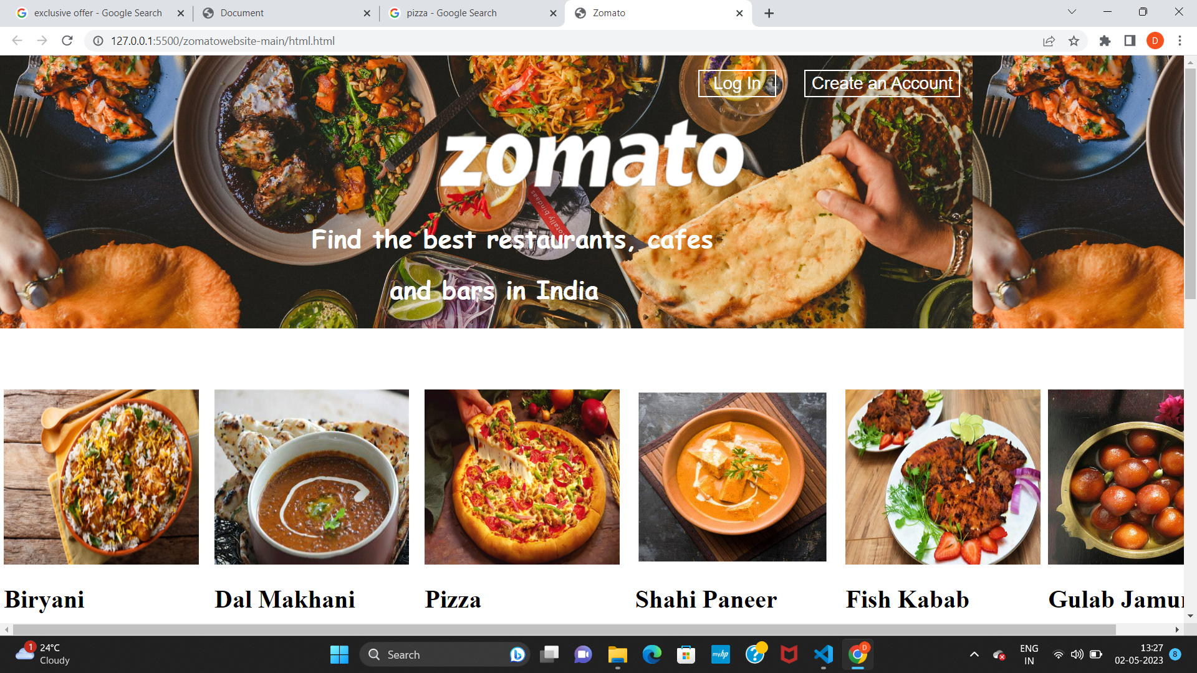
WEBPAGE:- ZOMATO

Slide 8
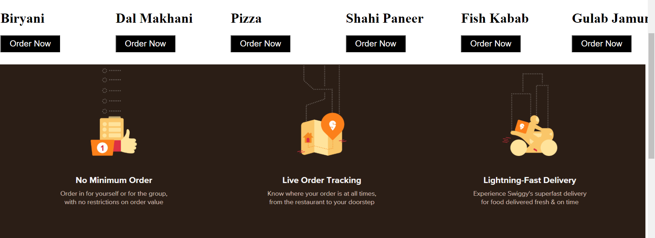
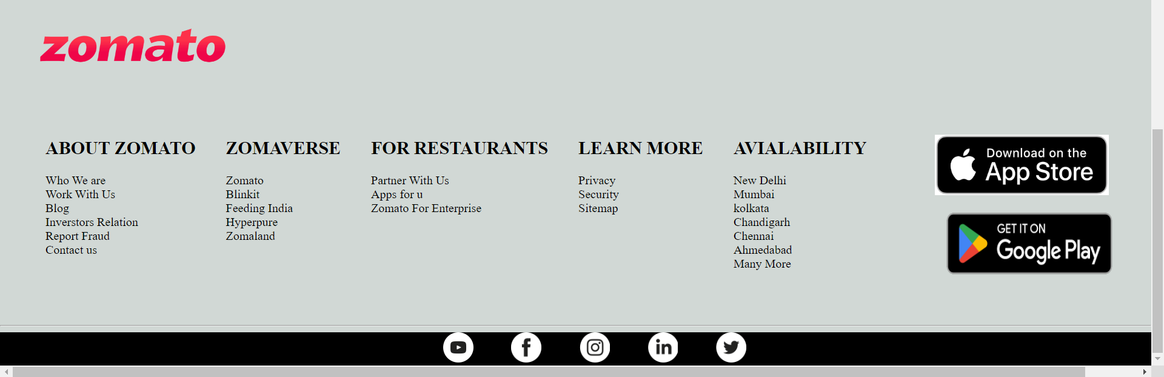
WEBPAGE:- ZOMATO

Slide 9

EXIT THE PLUGIN:- ZOMATO

Slide 10
Key Features
Design of an exit widget/plugin: The project focuses on the design and development of an exit plugin that is commonly used on websites and webpages to show pop-ups to the user when they attempt to exit the site/page.
Use of foundational web development languages: The project will utilize HTML, CSS, and JavaScript, which are the foundational languages for web development.
Incorporation with Attractive Web page:- The project not only describes the exit the plugin which is created but also view the website of Zomato where clubbing with javascript the plugin will display.

Slide 11
Project Highlights
Improved user engagement: By using an exit plugin, the website owner can increase user engagement by offering an attractive offer or message, which may persuade the user to stay on the website.
Cost-effective: The project is cost-effective as it only requires the use of foundational web development languages like HTML, CSS, and JavaScript.
Improved conversion rates: The project can improve conversion rates as users may be more likely to make a purchase or take the desired action when presented with an enticing offer or message.

Slide 12
Conclusion
In conclusion, the design and development of an exit widget or plugin offers a great opportunity to explore web development and user experience design concepts. This beginner-level project enables learners to apply their knowledge of HTML, CSS, and JavaScript, as well as to experiment with tools and libraries like jQuery or Bootstrap.
Overall, this project can serve as a foundation for more advanced projects and can inspire learners to explore new frontiers in web development and design.
The exit widget or plugin project has significant potential for future growth and development. The project can be expanded to integrate with other tools or platforms to enhance its functionality and usability

Slide 13
Future Scope:-
Dynamic Approach:- The website as of now is static in nature, the future scope include clubbing it with javascript so as to give it dynamic touch .
Efficient Features:- Various features like copy of the code and timer showing the time remaining for the offer will be added on the plug in approach
Order Online:- Approach will be taken to connect the website to certain net banking apps like paytm, google pay, phonepay so that user could also place order.

Slide 14
TEAM TAKEWAYS:-
1) The team gained valuable experience in collaborating remotely and communicating effectively using various tools and platforms.
2) The project provided the team with an opportunity to apply and further develop their technical skills in web development.
3) The team discovered the importance of regular code reviews and documentation to ensure project efficiency and maintainability.
4) The project highlighted the benefits of user testing and incorporating user feedback into the development process.
5) The team learned the value of taking breaks and pacing oneself during long coding sessions to prevent burnout.

Slide 15
References/Links used
The following references were consulted in the development of this project on Exit Plugins:
w3Schools :- https://www.w3schools.com/html/
javaTpoint :- https://www.javatpoint.com/javascript-tutorial
Developer Mozilla :- https://developer.mozilla.org/enUS/docs/Web/Guide/Introduction_to_Web_developmenta

Slide 16


